Slide 1

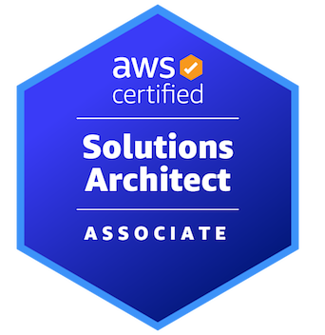

AWS CERTIFIED SOLUTIONS ARCHITECT - ASSOCIATE
Databases
AMBER ISRAELSEN
Developer | Technical Trainer
Notes:
m8-01 = “Module Introduction”
Hi friends, and welcome to this next module in the AWS Certified Solutions Architect Associate course. I’m Amber Israelsen.

Slide 2
Course Outline (Part 1)
Course Introduction
AWS Cloud Practitioner Refresher
Authentication and Authorization – Identity and Access Management (IAM)
Compute
Elastic Load Balancing and Auto Scaling
Networking
Storage
Databases
Data Migration and Transfer
Analytics
Notes:
In this module, we’re moving on to talk about databases in AWS.

Slide 3

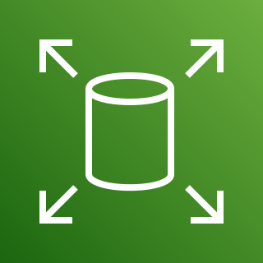

So Many Ways to Store Data!
S3
EBS
EFS
Notes:
We’ve already seen several ways to store data in AWS—things like S3 buckets, EBS volumes that are attached to EC2 instances, Elastic File system—and on and on. It’s a lot, right?

Slide 4
Retrieve all orders for this customer for the last two years
Notes:
But what if you need to query or search through that data? Something like, I want to retrieve all orders for a particular customer for the last two years.
It would be pretty difficult to do that by looking through an S3 bucket or looking on what’s effectively a hard drive of a server with an EBS volume.
So you need a database—to store your data in a more structured way that shows relationships between data and allows you to easily and quickly search through it. Which is why you need a database.
Let’s dive in.

Slide 5
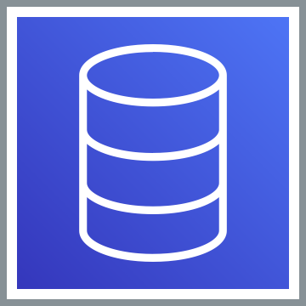
DATABASES IN AWS
Notes:
m8-02 = “Overview of Databases in AWS”
Databases in AWS.

Slide 6
Purpose-Built Databases in AWS
DATABASE TYPE | USE CASE | AWS SERVICE
Relational | Traditional apps, CRM, eCommerce | Amazon RDS, Aurora, Redshift
Non-Relational or NoSQL (key-value) | High-traffic web apps, eCommerce, Gaming | Amazon DynamoDB
In-memory | Caching, session management | Amazon ElastiCache
Graph | Fraud detection, social networking, recommendation engines | Amazon Neptune
Notes:
There are several types of databases available, and you’ll hear the term “purpose-built,” meaning they’re really optimized for a specific use case. There are actually more than you see on the slide here, but for exam purposes, we’re just going to focus on these.
We’ll hit on relational, non-relational or sometimes referred to as NoSQL, in-memory and graph. And over on the right, you’ll see the five AWS services that cover these areas.

Slide 7
Managed Database Service
A database where Amazon does all the underlying administrative work (backups, patching, recovery, etc.)
vs.
You installing the database directly on a server and managing it
Notes:
Now, the databases we’re going to talk about are managed databases, which basically means it’s a database where Amazon does all the underlying administrative work of setting up the actual server that it runs on, doing the backups, patching, recovery and so on.
So rather than you (click) setting up a new (click) server and installing something like Microsoft SQL Server directly on the server and managing it, all of that stuff is done for you.

Slide 8
Purpose-Built Databases in AWS
DATABASE TYPE | USE CASE | AWS SERVICE
Relational | Traditional apps, CRM, eCommerce | Amazon RDS, Aurora, Redshift
Non-Relational or NoSQL (key-value) | High-traffic web apps, eCommerce, Gaming | Amazon DynamoDB
In-memory | Caching, session management | Amazon ElastiCache
Graph | Fraud detection, social networking, recommendation engines | Amazon Neptune
Notes:
m8-03 = “Amazon Relational Database Service (RDS) Overview”
Let’s start our database discussion with relational databases.

Slide 9
Relational Databases
CUSTOMERS
CustomerID | FirstName | LastName | EmailAddress
1 | Dwight | Schrute | dwight.schrute@email.com
2 | Pam | Beasley | pam.beasley@email.com
3 | Jim | Halpert | jim.halpert@email.com
4 | Michael | Scott | michael.scott@email.com
ORDERS
OrderID | CustomerID | OrderDate | ShippingAddress
845 | 1 | 1/6/22 | 123 Main Street
846 | 3 | 12/30/21 | 555 Avenue F
847 | 4 | 12/28/21 | 628 Goldenrod
848 | 2 | 1/1/22 | 987 State Street
Notes:
If you’ve used a spreadsheet before—something like Microsoft Excel or Google Sheets, then you get the idea here.
You have a spreadsheet or a tab for Customers, and you have rows and columns. In a database, this would be a table.
(click) Customers have orders, and so you can (click) relate them in this way. From the orders table, you reference the customer ID.
So that’s the idea with relational databases—a defined schema with the tables, rows and columns, and then relationships between them.

Slide 10
Structured Query Language (SQL)
Used to query a relational database
SELECT FirstName from CUSTOMERS
Notes:
To query a relational database, you’ll use what’s called structured query language or SQL, such as SELECT FirstName from the Customers table, which will return you a list of customers’ first names.

Slide 11
Purpose-Built Databases in AWS
DATABASE TYPE | USE CASE | AWS SERVICE
Relational | Traditional apps, CRM, eCommerce | Amazon RDS, Aurora, Redshift
Non-Relational or NoSQL (key-value) | High-traffic web apps, eCommerce, Gaming | Amazon DynamoDB
In-memory | Caching, session management | Amazon ElastiCache
Graph | Fraud detection, social networking, recommendation engines | Amazon Neptune
Notes:
Relational databases have been around for years and years, and are still very common today. And as far as AWS goes, the main services here are Amazon RDS (relational database service), Aurora and Redshift.

Slide 12
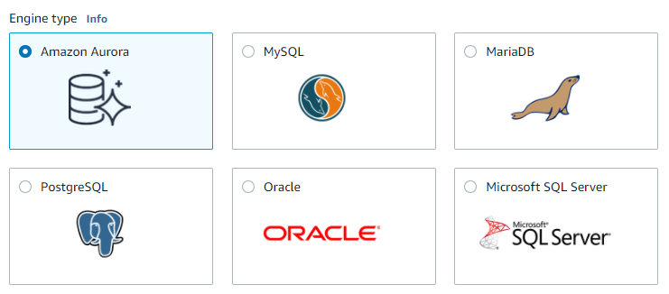
Notes:
There are six engines supported by RDS, shown here. A database engine is the underlying system that makes the database work—things like the query language, how to store and retrieve data, user management and so on.
So when we say we’re creating an RDS database, that’s just the overall service that Amazon offers, but then the actual database you create will be one of these six.

Slide 13

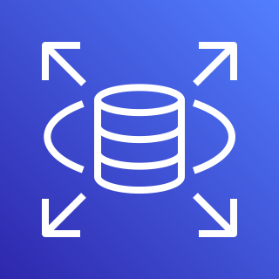


Read Replicas
Region
Availability Zone 1
Availability Zone 2
Create a read-only copy
RDS Instance
RDS Instance
Read and write access
Read access
Notes:
A topic that might come up on the exam is one called read replicas, so let me briefly touch on that. It goes something like this.
(click) Let’s say you have an application that lets users upload videos to share. For the user that’s uploading a video, they need both (click) read and write access—in other words, they need to insert something into the database, like the video, the video description and so on—and then they also need to be able to read from the database—or retrieve the thing they uploaded so they can view it on the site. And for that, you place an RDS database in one availability zone.
But then you have lots of users who DON’T need to upload videos, but they only want to view videos that are already out there. They just need read access. So what you can do is basically create a read-only copy—a replica—of your database and place it in another availability zone, and then that other group of users can read from that database. This not only reduces the load on the first database, but it also makes your application more highly available because you have things in two AZs now.

Slide 14
But wait, there’s more!
Notes:
But wait, there’s more!

Slide 15
CROSS-REGION Read Replicas
Region 1
Region 2
Availability Zone 1
Availability Zone 1
Create a read-only copy
RDS Instance
RDS Instance
Read and write access
Read access
Notes:
You can also implement this across regions. So rather than being in just one region and making a copy to a second availability zone, you can actually be in one region (click) and create the copy in an entirely different region.
On the exam, if you get questions about services that can work across multiple regions, RDS is one of those, because of this cross-region read-replica functionality.

Slide 16
Multi-AZ Deployments for High Availability
Region
Availability Zone 1
Availability Zone 2
Synchronous replication
RDS Primary Database
RDS Standby Replica
Notes:
Now let’s talk about multi-AZ deployments. This type of a setup will give you high availability and the ability to failover from one AZ to another if you ever need to.
The way this works is you have your (click) primary database instance in Availability Zone 1, and then (click) RDS automatically provisions a standby replica in a different availability zone.
(click) And then the primary DB is synchronously replicated across AZs so that you get that redundancy you want.

Slide 17
Multi-AZ Deployments for High Availability
Region
Availability Zone 1
Availability Zone 2
RDS Primary Database
RDS Standby Replica
Traffic automatically routed to the replica
Notes:
Then in the event that something happens with the primary database, RDS will automatically perform a failover to the standby replica so that database operations can resume quickly without human intervention.

Slide 18
RDS Read Replicas vs. Multi-AZ
Read Replicas
Multi-AZ
Asynchronous replication between master and read replicas
All read replicas are available and can be scaled
Automated backups taken by default; you must configure
Can be 1 AZ, cross-AZ or cross-region
Failover happens by manually promoting replica to a standalone instance
Synchronous replication between primary and standby
Only primary database instance is active
Automated backups taken from standby database
Always spans 2 AZs in 1 region
Failover happens automatically to the standby
Notes:
Now, those concepts of read replicas and multi-AZ deployments can all blur together a little bit, so here’s a side-by-side comparison.
Read…

Slide 19
Other Notes for High Availability with RDS
Snapshots can be made of EBS volumes on the database instances
Used for backup and recovery
Stored in S3, like all other EBS snapshots
Automated snapshots are also possible
Can impact performance, so choose a time when the database is less busy
Auto Scaling for RDS
Scales up storage capacity on the database instance when usage is reaching the limits of its provisioned size
Does not cause downtime or disrupt in-flight operations/transactions
Notes:
A few other notes about achieving high availability with RDS.
You can create snapshots of the EBS volumes on the database instances, and these can be used for backup and recovery. These are just like any other EBS snapshot, and they’ll be stored in S3.
And automated snapshots are also available, where you tell RDS to create a snapshot daily during a 30-minute window that either you specify or you can let RDS pick the time. This will impact performance a little bit, so it’s usually best to specify the window yourself, and pick a time when the database is less busy.
And we’ll talk a lot more about backup and recovery in a future module in the course, and there’s a whole section about databases there.
You can also use auto scaling with RDS.
Scales up storage capacity on the database instance when usage is reaching the limits of its provisioned size
And important thing to note is that this doesn’t cause downtime or disrupt any in-flight operations/transactions

Slide 20
DEMO
Amazon RDS: Creating and Connecting to a MySQL Database
Notes:
m8-04 = “DEMO: Amazon RDS: Creating and Connecting to a MySQL Database” – re-use m4-60
Start at the RDS console: https://us-east-2.console.aws.amazon.com/rds/home?region=us-east-2#GettingStarted:
-Standard create allows you to pick everything – choose this one
-Easy create – where Amazon has automatically configured things based on best practices
We’ll pick Standard, and I’ll highlight just a few things as we go.
Now, as we talked about a minute ago, there are six engines available. Amazon Aurora is actually built BY Amazon, so built specifically for the cloud. You might be familiar with some of the others.
For this demo, I’m going to go with MySQL.
Db instance size: This is the EC2 instance, or virtual server, that’s going to actually run the database. Go with free tier.
Public access: Yes
When we’re done, I’m going to show you how to connect to the database from SQL Server Management Studio, which is running on my laptop. So I’ll need this to be publicly accessible. If it’s not, you can only access the database from within a VPC. Which in the real world, is probably a good idea, but for demo purposes, I’ll make this publicly accessible.
Default everything else
Create (takes 7-8 minutes)
All right. While that’s running, let’s talk about how we’re going to connect to this database once it’s up and running. If you’ve done any work with SQL Server in the past, you might be familiar with a tool called MySQL Workbench. It’s free and you can download it from here: https://dev.mysql.com/downloads/workbench/
But first, our database needs to be in an Available state…it can’t be creating or configuring backing up or anything like that. Pause video and come back.
All right. Now, our database instance has been created and everything is good to go (click into it). To connect to it from MySQL Workbench, we’re going to need a few things.
On the Connectivity & Security tab, we’ll need the Endpoint and also the port (3306).
And then on the Configuration tab, if you’ve forgotten it already, here’s where you can find the username that you specified earlier (admin in our case).
We also need to modify our inbound rules for the security group to add a rule for MYSQL/Aurora (3306) from My IP
So let’s head over to MySQL Workbench, new Connection
Enter endpoint and port (should default to 3306)
credentials
Test
Now once you’re in here, you can expand the sys database, which is one you get by default (on the Schemas tab). You can also create your own schema or database, add tables and so on.
You can run scripts (New Query, select @@VERSION)
I’m not really going to get into too much more detail here. Just know that for working with relational data, you want to use RDS, and then you can choose from one of the six engines, MySQL being just one of them.

Slide 21
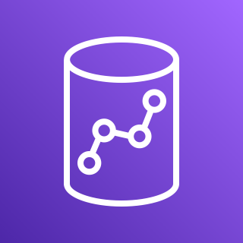
Amazon Redshift
Data warehousing service
Can handle massive amount of data (exabytes), structured and unstructured
OLAP-style (Online Analytical Processing) columnar database based on PostgreSQL
Can use SQL queries
Use cases
Real-time analytics
Log analysis
Combining multiple data sources
Notes:
m8-05 = “Amazon Redshift Overview” – re-use m4-61
The second and last relational database we’ll talk about is Amazon Redshift. We’ll cover this one at a very high level as far as what you need to know for the exam.
Redshift is a data warehousing service. If you aren’t familiar with the term data warehousing, think of it as a giant warehouse used to store and report on data, and it typically pulls in that data from a lot of different sources—like S3, lots of different databases, file systems and so on. So it’s kind of a central repository. If you get a question on the exam about data warehousing, Redshift should be the first thing you think about.
And it really shines in its ability to handle a massive amount of data—exabytes, really—and the data can be structured or unstructured.
Go to next slide…

Slide 22
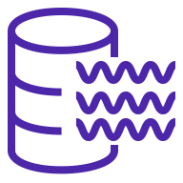
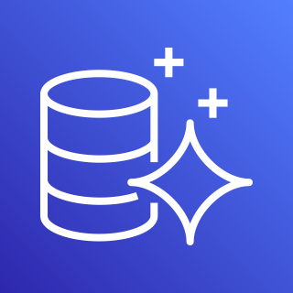


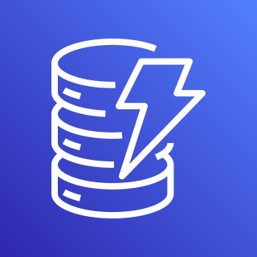

Amazon Redshift
S3 Data Lake
Aurora
QuickSight
SageMaker
Redshift
RDS
DynamoDB
Athena
Analytics and Machine Learning Tools
Notes:
(click) So basically how it works is you’ve got data from a variety of places—maybe an S3 data lake, an Aurora database, DynamoDB, what have you…
(click) That all gets loaded into Redshift.
(click) And then there are analytics, BI and machine learning various tools and services you can use to analyze the data, create dashboards and so on.

Slide 23
Amazon Redshift
Data warehousing service
Can handle massive amount of data (exabytes), structured and unstructured
OLAP-style (Online Analytical Processing) columnar database based on PostgreSQL
Can use SQL queries
Use cases
Real-time analytics
Log analysis
Combining multiple data sources
Notes:
Start on second main bullet
Redshift is an OLAP-style database, which stands for online analytical processing—so again, for purposes of the exam, if you get something about using data for analytics, Redshift should come to mind. This is built on PostgreSQL, which as that name suggests, means you can run SQL queries against it.
And the use cases here, which I’ve already kind of alluded to—real-time analytics, analyzing logs, and generally combining multiple data sources to do some kind of analysis.

Slide 24
Purpose-Built Databases in AWS
DATABASE TYPE | USE CASE | AWS SERVICE
Relational | Traditional apps, CRM, eCommerce | Amazon RDS, Aurora, Redshift
Non-Relational or NoSQL (key-value) | High-traffic web apps, eCommerce, Gaming | Amazon DynamoDB
In-memory | Caching, session management | Amazon ElastiCache
Graph | Fraud detection, social networking, recommendation engines | Amazon Neptune
Notes:
m8-06 = “Database: Amazon DynamoDB Overview”
Now moving on to non-relational databases or NoSQL databases. In the big scheme of things, this is a newer way to store data, and it’s really become popular in recent years for high-traffic web apps, eCommerce and gaming. These have a much more flexible schema, which makes it easier to scale them and get better performance. DynamoDB is the primary AWS service here. So let’s look at how these work.

Slide 25
Non-Relational/NoSQL Databases
JSON
{
"first name": "Jeremy",
"last name": "Dunn",
"age": 27,
"hobbies": [
"Hiking",
"Surfing",
"Kayaking"
],
"address": {
"number": "2401",
"street": "Monterey Avenue",
"city": "Monterey",
"state": "CA"
}
}
Supports arrays
Flexible schema
And nesting…
Notes:
Here, rather than storing your data in tables, it’s commonly represented as JSON code, which stands for JavaScript Object Notation, and there’s an example here.
Here we have information about a person Jeremy Dunn. It supports arrays (click), such as the hobbies listed here. And you can (click) also nest data, like the address.
And in general, this schema is much more flexible than a relational database schema. If you want to add a new field or key for, say, occupation or favorite foods or whatever, you can just add that.

Slide 26
Key-Value Database
KEY
VALUE
City
Seattle
State
WA
Country
USA
Notes:
DynamoDB is a key-value database, which is one of the more popular forms of NoSQL. If you’re not familiar with this, it essentially works like this. You have a unique set of identifiers—the keys—that each have an associated value. So basically two pieces of data that are associated with each other.

Slide 27
DynamoDB Benefits and Use Cases
High performance, very fast for read and write operations
Massively scalable and serverless
Highly available across three Availability Zones
Notes:
As far as the benefits of DynamoDB, it’s very fast for read and write operations, and related to being fast, it’s also massively scalable and serverless. It’s complicated to scale relational databases, but because of the flexible structure of DynamoDB, your data can be scaled out automatically to meet increased load.
And that’s what I mean here by serverless—you don’t have to go and provision servers ahead of time and guess how much capacity you need. Amazon does that for you based on demand.
It’s also highly available across three availability zones.

Slide 28
Scaling and Performance for DynamoDB
Scaling
Auto scaling (“provisioned”): You set target, min and max capacity, and AWS will try to meet it
On-demand: Scaling happens automatically based on demand (similar to serverless/Lambda)
More expensive than auto scaling/provisioned
DynamoDB Accelerator (DAX)
Fully managed, in-memory cache for DynamoDB
Delivers up to a 10 times performance (microsecond READ latency), even with millions of requests per second
No re-coding necessary; provision a DAX cluster and shift existing calls to it
Similar performance results as ElastiCache, but with less effort
Notes:
DynamoDB – there are actually two options here for scaling.
Auto scaling (also called “provisioned”): You set target, min and max capacity, and AWS will try to meet it. So here, you’re going to have to have some idea of the kind of traffic you’re expecting.
On-demand: Scaling happens automatically based on demand (similar to serverless/Lambda). This is a good option if you really have no idea what the traffic will be like; let AWS figure that out and manage it for you.
This option IS going to be more expensive than the auto scaling/provisioned option above it
And then on the performance side, the important service here is called DynamoDB Accelerator, or DAX.
Fully managed, in-memory cache for DynamoDB
Delivers up to a 10 times performance (microsecond read latency), even with millions of requests per second. So on the exam, if you get something about needing SUPER fast READ performance, this would be a good option.
Importantly, there’s no re-coding necessary; provision a DAX cluster and shift existing calls to it. So if you have a question about an application that needs better performance but can’t be rewritten, if it’s using DynamoDB as the database, then DAX is probably a good solution.
And DAX can seem similar to ElastiCache because they’re both caching solutions. You can get similar performance boosts with both, but with DAX will require a lot less effort, and is really optimized for a DynamoDB scenario.

Slide 29
DEMO
Creating a DynamoDB Table
Notes:
m8-07 = “DEMO: Creating a DynamoDB Table” – re-use m4-63
Okay, moving on to the non-relational or NoSQL database…
Navigate to DynamoDB
Create table: Customers
Now, I’ll point out here, we’re creating a table, not a database. If you’ll remember, with RDS, we had to provision an instance for a database, which installed some default databases. And then we’d actually have to create our own custom database after that, which would hold tables. But here we’re just creating a table right away. Because DynamoDB is serverless, all of that underlying infrastructure work is being handled for us.
Partition Key: customer_id, String
(you won’t need to know sort keys for the exam; optional)
Default settings
Create
View items
Create item
customer_id: 1
Add attributes
first_name: Art
last_name: Vandalay
city: Seattle
state: Washington
Create item
Now you’ll see that the schema is inferred from the attributes we entered.
Enter another item:
customer_id: 1
first_name: Art
last_name: Vandelay
city: New York City
state: New York
Create item
customer_id: 2
first_name: Bob
last_name: Sacamano
age (number): 62
So you’ll see here that we have different values—in this second one, I have an age, where I didn’t in the first. And then I stopped city and state in the second one. And that all works just fine in a non-relational database. It’s a very flexible way to store your data. We’re just putting all of our data here in this table; we aren’t joining it to another like we would in a relational database.

Slide 30
Purpose-Built Databases in AWS
DATABASE TYPE | USE CASE | AWS SERVICE
Relational | Traditional apps, CRM, eCommerce | Amazon RDS, Aurora, Redshift
Non-Relational or NoSQL (key-value) | High-traffic web apps, eCommerce, Gaming | Amazon DynamoDB
In-memory | Caching, session management | Amazon ElastiCache
Graph | Fraud detection, social networking, recommendation engines | Amazon Neptune
Notes:
m8-08 = “Amazon ElastiCache Overview”
Next, we have in-memory databases, which are used for caching and session management.

Slide 31
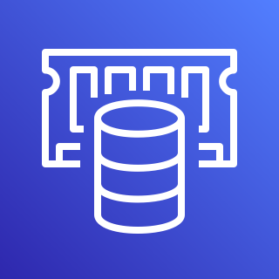
In-Memory Database
Get Top 10 Movies
RDS Database
Get Top 10 Movies
In-Memory Database
ElastiCache
Notes:
The idea here is that you can speed things up by storing and retrieving data in memory rather than on a disk in a database.
For example (click), if you have a read-heavy website—maybe users are requesting the top 10 movies. And you’re going to the database every time to query and retrieve that data over and over. That can put a lot of load on the database, and it’s relatively slow to have to read from a database or a hard disk vs. doing it from memory.
So instead (click), you cache that in memory using ElastiCache, and then you’re able to retrieve it much faster. And this also takes some of the load off the database so it can do other things.

Slide 32
ElastiCache Benefits and Use Cases
Managed caching service
Removes the complexity of deploying and managing a distributed cache environment
Compatible with Redis or Memcached engines
Integration with other AWS services
Use cases
Distributed session management
vs. “sticky sessions” with a load balancer
Read-intensive web applications
Real-time apps that require fast data access
Notes:
ElastiCache is a managed caching service effectively, which removes the complexity of deploying and managing the environment.
It’s compatible with Redis or Memcached (memcache-D) engines, which are two popular caching technologies. This means you can easily move an existing caching implementation over to AWS.
ElastiCache seamlessly integrates with other AWS services like EC2, CloudWatch and more.
And as far as where this makes the most sense, Elasticache is ideal for distributed session management. You might remember in our load balancer section, we talked about creating “sticky sessions” where all requests are sent to the same instance. This is kind of the opposite of that. Here, you’re doing the session management for many sessions from a single place. On the exam, if you get a question about distributed session management, then ElastiCache should come to mind.
It’s also good for read-intensive web applications and real-time apps that require fast access to data. Think about apps like gaming, ride sharing, media streaming or social media.

Slide 33
Purpose-Built Databases in AWS
DATABASE TYPE | USE CASE | AWS SERVICE
Relational | Traditional apps, CRM, eCommerce | Amazon RDS, Aurora, Redshift
Non-Relational or NoSQL (key-value) | High-traffic web apps, eCommerce, Gaming | Amazon DynamoDB
In-memory | Caching, session management | Amazon ElastiCache
Graph | Fraud detection, social networking, recommendation engines | Amazon Neptune
Notes:
m8-09 = “Amazon Neptune Overview” – re-use m4-65
Lastly, we have graph databases, which are commonly used for fraud detection, social networking and recommendation engines. And the AWS service here is Amazon Neptune.

Slide 34
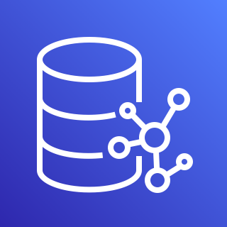





Graph Database
Barb
Neptune
Kedwin
Friends with
Post 1
Friends with
Posted
Commented on
Posted
Kelly
Post 1
Posted
Friends with
Post 2
Jeff
Ali
Posted
Friends with
Liked
Post 3
Liked
Posted
Post 1
Notes:
That social networking example is actually a good way to understand how this works—where you’ve got something like this (click). There are a lot of different relationships between people and their activities—whether it’s that someone is friends with someone else, whether they like a post or comment on a post—and a whole host of other actions that can be taken. (click) The Neptune icon shows a similar structure, with that graph.
A graph database is really optimized to handle this—storing and retrieving the data, and also running analytics on it. And as mentioned on the previous slide, graph databases are also commonly used for fraud detection scenarios as well as recommendation engines—like when Amazon recommends a product similar to one you’re currently looking at.
So for purposes of the exam, if you get any questions about graph databases, then you’ll want to think of Neptune.

Slide 35
Important Points to Remember
RELATIONAL DATABASE SERVICE (RDS)
Relational database service with six engines available (Aurora, MySQL, PostgreSQL, etc.)
Managed database service
AWS does all the underlying administrative work
You are responsible for network access and managing database users and permissions
Read replicas used for read-heavy applications, where read-only traffic is directed to the replica, alleviating traffic from the primary database
Also works cross-region
Multi-AZ deployments provide high availability by synchronously (and automatically) replicating the primary database to a standby replica
REDSHIFT
Used for data warehousing and analytics
A central repository of data that pulls from many other sources (e.g., S3, databases, etc.)
Notes:
m8-10 = “Important Points to Remember”
Now let’s recap the important points from this section about Databases in AWS.

Slide 36
Important Points to Remember
DYNAMODB
Non-relational or NoSQL database
Data stored as key/value pairs
Massively scalable and highly performant
Two options for scaling: 1: Auto scaling (provisioned) 2: On-demand (more expensive)
DynamoDB Accelerator is in-memory caching, delivering 10x performance with microsecond READ latency
No re-coding necessary
ELASTICACHE
In-memory database used for caching and session management
Used for read-intensive web applications, such as gaming or media streaming
NEPTUNE
Graph database
Used for social media, fraud detection and recommendation engines

